Slide 1
TITANIC SURVIVOR PREDICTION
PRESENTED BY: GUNJAN

Slide 2
CONTENT
INTRODUCTION
GOALS AND OBJECTIVES
WORKFLOW
DATA ANALYSIS
DATA FRAME
HEADING MISSING VALUES
DATA VISUALISATION
SEX COLUMN
SURVIVORS GENDER WISE
PCLASS- TICKET CLASS
TRANSFORMATIONAL INTO CATEGORICAL COLUMN
SPLIT THE DATA
CALCULATE ACCURACY OF TRAIN DATA AND TEST DATA
CONCLUSION

Slide 3
INTRODUCTION
The sinking of the rms titanic is one of the most infamous shipwrecks in history.
In this challenges, we ask you to complete the analysis of what sorts of people were likely to survive.
In particular, we ask you to apply the tools of machine learning to predict which passengers survived the tragedy.

Slide 4
GOALS AND OBJECTIVES
.The purpose of this project is to document the process I went through to create my predictions for TITANIC SURVIVOR PREDICTION.
Binary classification is the task of classifying the elements of a set into two groups on the basis of a classification rule.

Slide 5
Software required
• TOOLS USED
1. Anaconda Navigator-1.9.6
2. Jupyter Notebook- 5.7.4
. LIBRARY USED
1. Analysing: Numpy, Pandas, Sci-kit Learn
2. Visualization: Matplotlib, Seaborn

Slide 6
LOGISTIC REGRESSION
. Logistic regression is basically a supervised classification algorithm. In a classification problem ,the target variable(or output),y ,can take only discrete values for given set of features (or input), X.
. Some of the examples of classification problems are Emails spam or not spam, Online transaction Fraud or not Fraud.

Slide 7
IMPLEMENTATION
. Importing the necessary libraries
. Importing the dataset
. Cleaning and analyzing the dataset
. Building the model
. Using logistic regression for making prediction

Slide 8
IMPORTING THE NECESSARY LIBRARIES
import numpy as np
import pandas as pd
import matplotlib.pyplot as plt
import seaborn as sns
from sklearn.model_selection import train_test_split
from sklearn.linear_model import LogisticRegression
from sklearn.metrics import accuracy_score

Slide 9
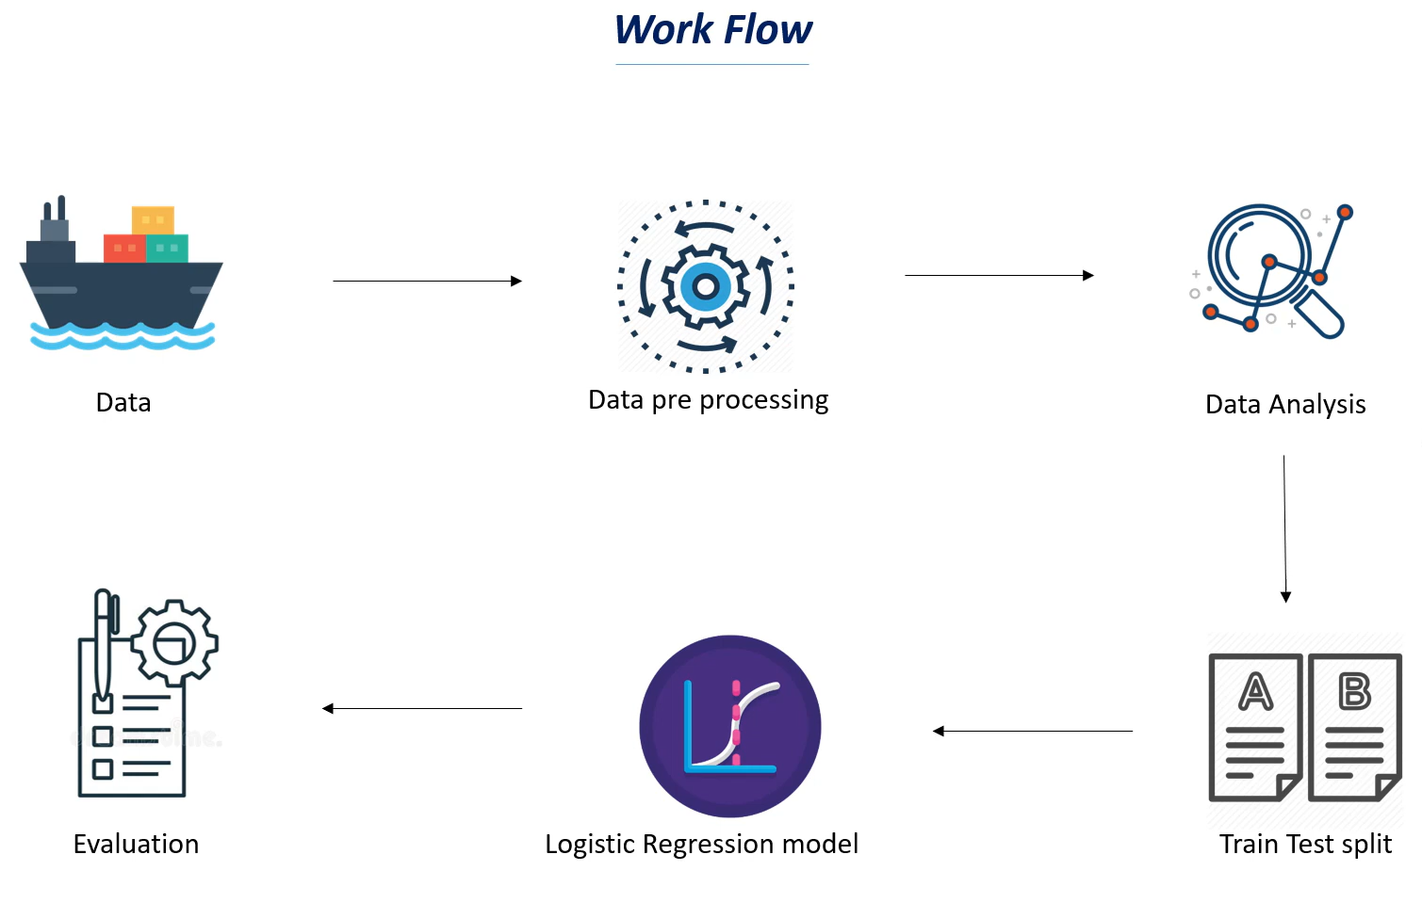

Slide 10
data analysis
titanic_data.describe()
 | PassengerId | Survived | Pclass | Age | SibSp | Parch | Fare
count | 891.000000 | 891.000000 | 891.000000 | 891.000000 | 891.000000 | 891.000000 | 891.000000
mean | 446.000000 | 0.383838 | 2.308642 | 29.699118 | 0.523008 | 0.381594 | 32.204208
std | 257.353842 | 0.486592 | 0.836071 | 13.002015 | 1.102743 | 0.806057 | 49.693429
min | 1.000000 | 0.000000 | 1.000000 | 0.420000 | 0.000000 | 0.000000 | 0.000000
25% | 223.500000 | 0.000000 | 2.000000 | 22.000000 | 0.000000 | 0.000000 | 7.910400
50% | 446.000000 | 0.000000 | 3.000000 | 29.699118 | 0.000000 | 0.000000 | 14.454200
75% | 668.500000 | 1.000000 | 3.000000 | 35.000000 | 1.000000 | 0.000000 | 31.000000
max | 891.000000 | 1.000000 | 3.000000 | 80.000000 | 8.000000 | 6.000000 | 512.329200

Slide 11
titanic_data.head()
DATAFRAME
 | PassengerId | Survived | Pclass | Name | Sex | Age | SibSp | Parch | Ticket | Fare | Cabin | Embarked
0 | 1 | 0 | 3 | Braund, Mr. Owen Harris | male | 22.0 | 1 | 0 | A/5 21171 | 7.2500 | NaN | S
1 | 2 | 1 | 1 | Cumings, Mrs. John Bradley (Florence Briggs Th... | female | 38.0 | 1 | 0 | PC 17599 | 71.2833 | C85 | C
2 | 3 | 1 | 3 | Heikkinen, Miss. Laina | female | 26.0 | 0 | 0 | STON/O2. 3101282 | 7.9250 | NaN | S
3 | 4 | 1 | 1 | Futrelle, Mrs. Jacques Heath (Lily May Peel) | female | 35.0 | 1 | 0 | 113803 | 53.1000 | C123 | S
4 | 5 | 0 | 3 | Allen, Mr. William Henry | male | 35.0 | 0 | 0 | 373450 | 8.0500 | NaN | S

Slide 12
Heading the missing values
titanic_data.isnull().sum()
PassengerId 0
Survived 0
Pclass 0
Name 0
Sex 0
Age 177
SibSp 0
Parch 0
Ticket 0
Fare 0
Cabin 687
Embarked 2
dtype: int64

Slide 13
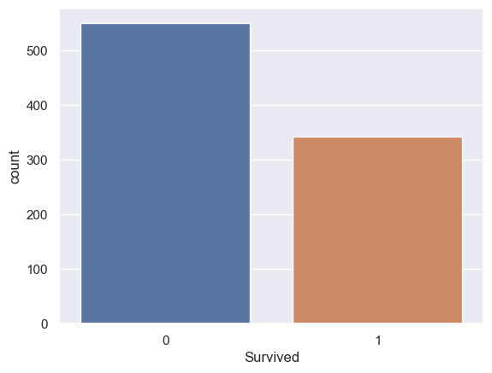
DATA VISUALISATION
SURVIVED COUNT
sns.countplot(x='Survived', data=titanic_data)
<Axes: xlabel= ‘Survived’, ylabel =‘count’>

Slide 14
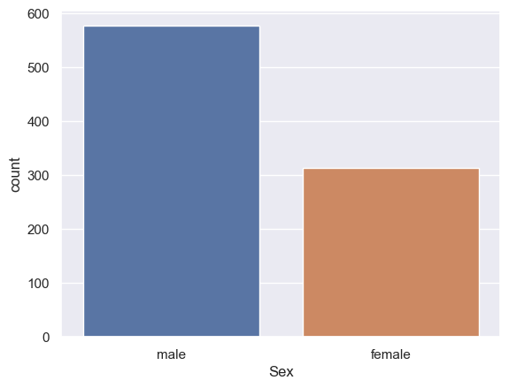
SEX COLUMN
SEX COUNT
sns.countplot(x='Sex',data=titanic_data
<Axes: xlabel=‘Sex’, ylabel=‘count’

Slide 15
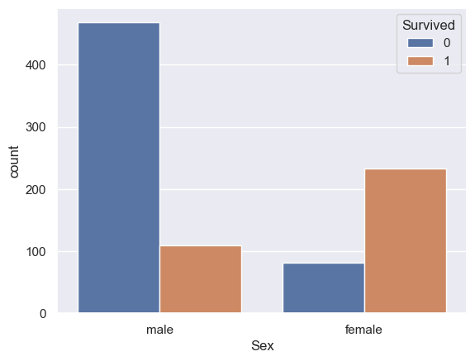
SURVIVORS GENDER WISE
sns.countplot(x='Sex',hue='Survived', data=titanic_data)
<Axes: xlabel = ‘Sex’, ylabel = ‘count’>

Slide 16
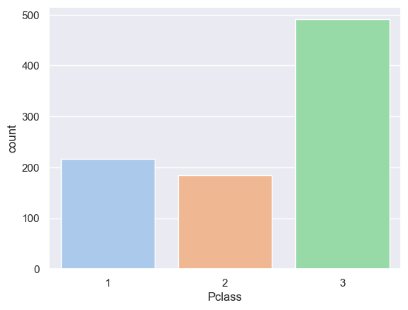
Pclass : TICKET CLASS
sns.countplot(x='Pclass',data=titanic_data ,palette='pastel')
<Axes: xlabel=’ Pclass ‘, ylabel =‘count’>

Slide 17
Transformational into a Categorical Columns
titanic_data.replace({'Sex':{'male':0,'female':1},'Embarked':{'S':0,'C':1,'Q':2}},inplace=True)
titanic_data.head()
 | PassengerId | Survived | Pclass | Name | Sex | Age | SibSp | Parch | Ticket | Fare | Embarked
0 | 1 | 0 | 3 | Braund, Mr. Owen Harris | 0 | 22.0 | 1 | 0 | A/5 21171 | 7.2500 | 0
1 | 2 | 1 | 1 | Cumings, Mrs. John Bradley (Florence Briggs Th... | 1 | 38.0 | 1 | 0 | PC 17599 | 71.2833 | 1
2 | 3 | 1 | 3 | Heikkinen, Miss. Laina | 1 | 26.0 | 0 | 0 | STON/O2. 3101282 | 7.9250 | 0
3 | 4 | 1 | 1 | Futrelle, Mrs. Jacques Heath (Lily May Peel) | 1 | 35.0 | 1 | 0 | 113803 | 53.1000 | 0
4 | 5 | 0 | 3 | Allen, Mr. William Henry | 0 | 35.0 | 0 | 0 | 373450 | 8.0500 | 0

Slide 18
SPLIT THE DATA
X = titanic_data.drop(columns = ['PassengerId','Name','Ticket','Survived'],axis=1) Y = titanic_data['Survived’]
Here, X is the feature variable, containing all the features like Pclass, Age, Sex, Embarked, etc. excluding the Survived column.
Y, on the other hand, is the target variable, as that is the result that we want to determine,i.e, whether a person is alive.
Now, we will be splitting the data into four variables, namely, X_train, Y_train, X_test, Y_test.
X_train, X_test, Y_train, Y_test = train_test_split(X,Y, test_size=0.2, random_state=2)
print(X.shape, X_train.shape, X_test.shape)
(891, 7) (712, 7) (179, 7)

Slide 19
CALULATING ACCURACY ON TRAINIG DATA
Let’s name a variable X_train_prediction, which will store all the predictive outputs of the values X_train.
X_train_prediction = model.predict(X_train)
Now, to check how accurate was its prediction, we compare the values of X_train_prediction with Y_train, which was the original real-life data.
training_data_accuracy = accuracy_score(Y_train, X_train_prediction)
print('Accuracy score of training data : ', training_data_accuracy)
Accuracy score of training data: 0.8075842696629213

Slide 20
CALULATING ACCURACY ON TEST DATA
X_test_prediction = model.predict(X_test)
test_data_accuracy = accuracy_score(Y_test, X_test_prediction)
print('Accuracy score of test data : ', test_data_accuracy)
Accuracy score of test data: 0.7821229050279329

Slide 21
CONCLUSION
The accuracy given by Linear regression is 0.7821229050279329 .

Slide 22
THANKYOU

